Slide 1
From atoms to stars II: the lives of stars
Richard J. Stancliffe
(University of Hull, UK)

Slide 2
Overview
The stages of a star’s life
Where and when does nuclear fusion happen?
What happens to star’s of different initial mass?

Slide 3
Phases of a star’s life
Red supergiant
Black hole
Main sequence
White dwarf
Supernova
Red giant
Neutron star
Asymptotic giant branch
Planetary nebula

Slide 4
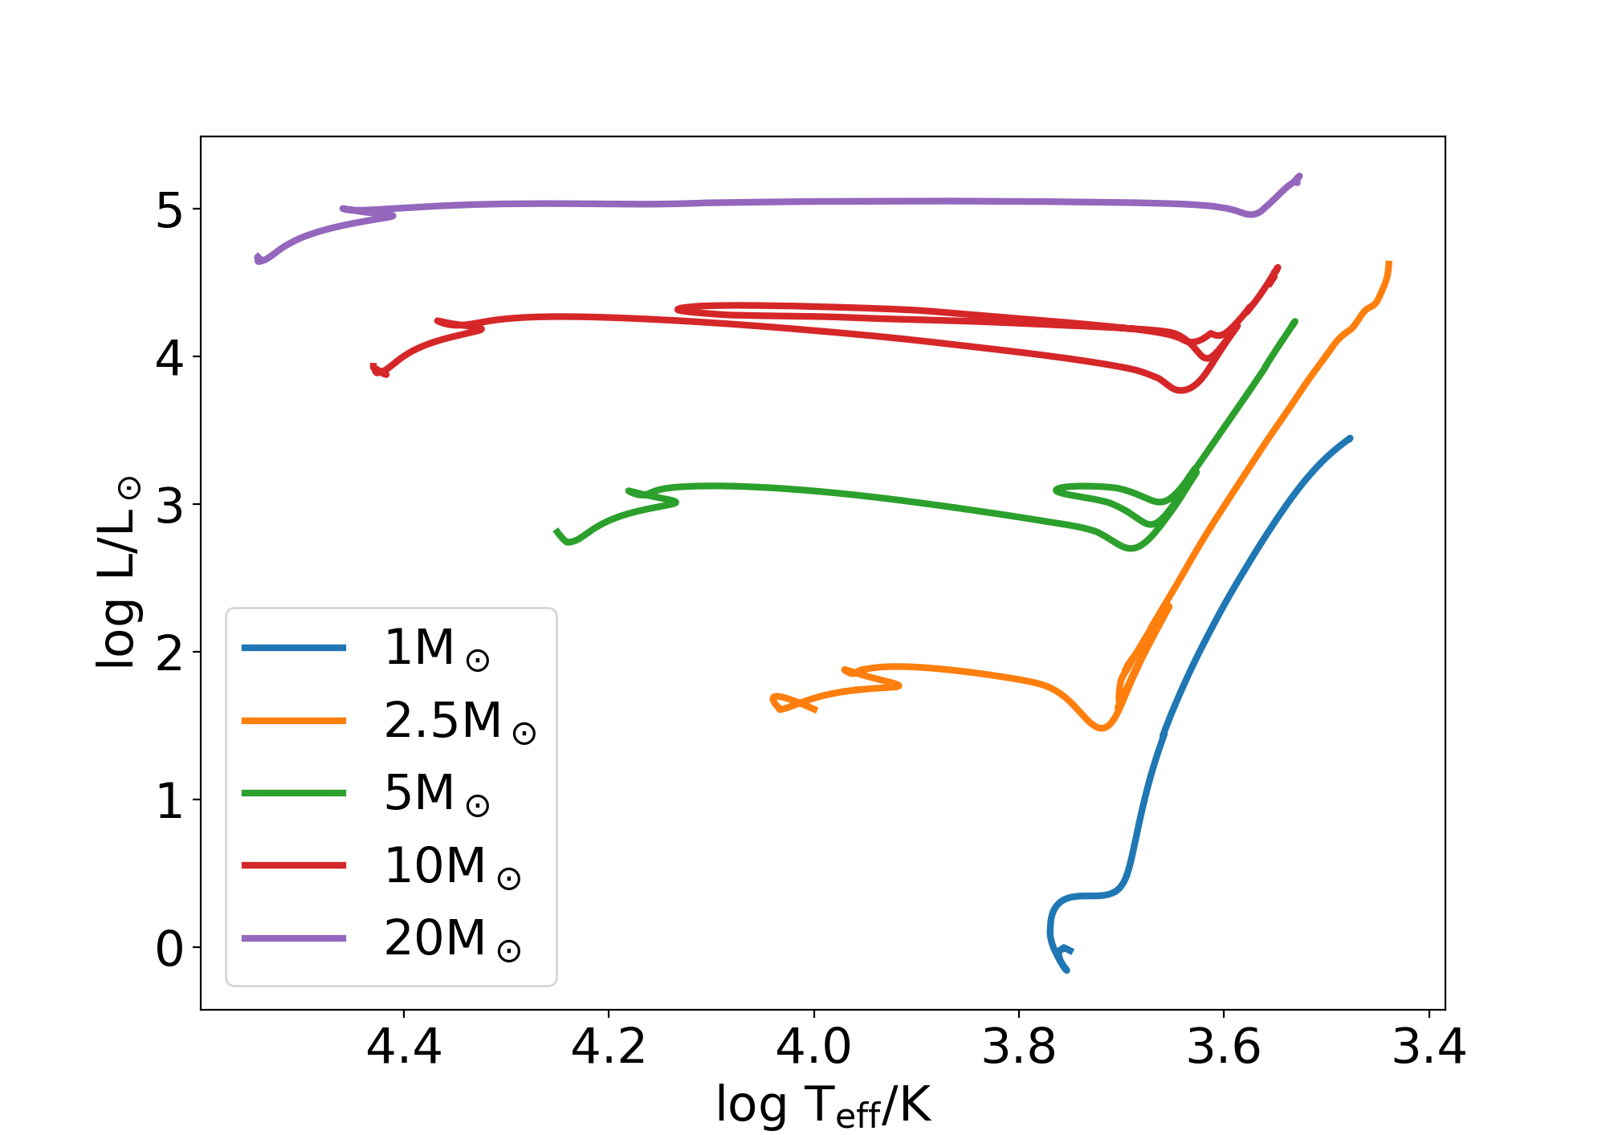
The Hertzsprung-Russell Diagram
Brightness and temperature are easy to measure
Observers use colour and magnitude
Theorists use temperature and luminosity
We can plot how these quantities change for a star of a given mass
We call these evolutionary tracks

Slide 5
What is the important physics?
Gravity versus pressure
Mass wants to make the star contract
Pressure tries to push the star apart
Needs a source of energy – nuclear power!

Slide 6
The Fates of Stars
Initial mass (Solar masses)
Core hydrogen burning
0.08
200?
Evolution stage reached

Slide 7
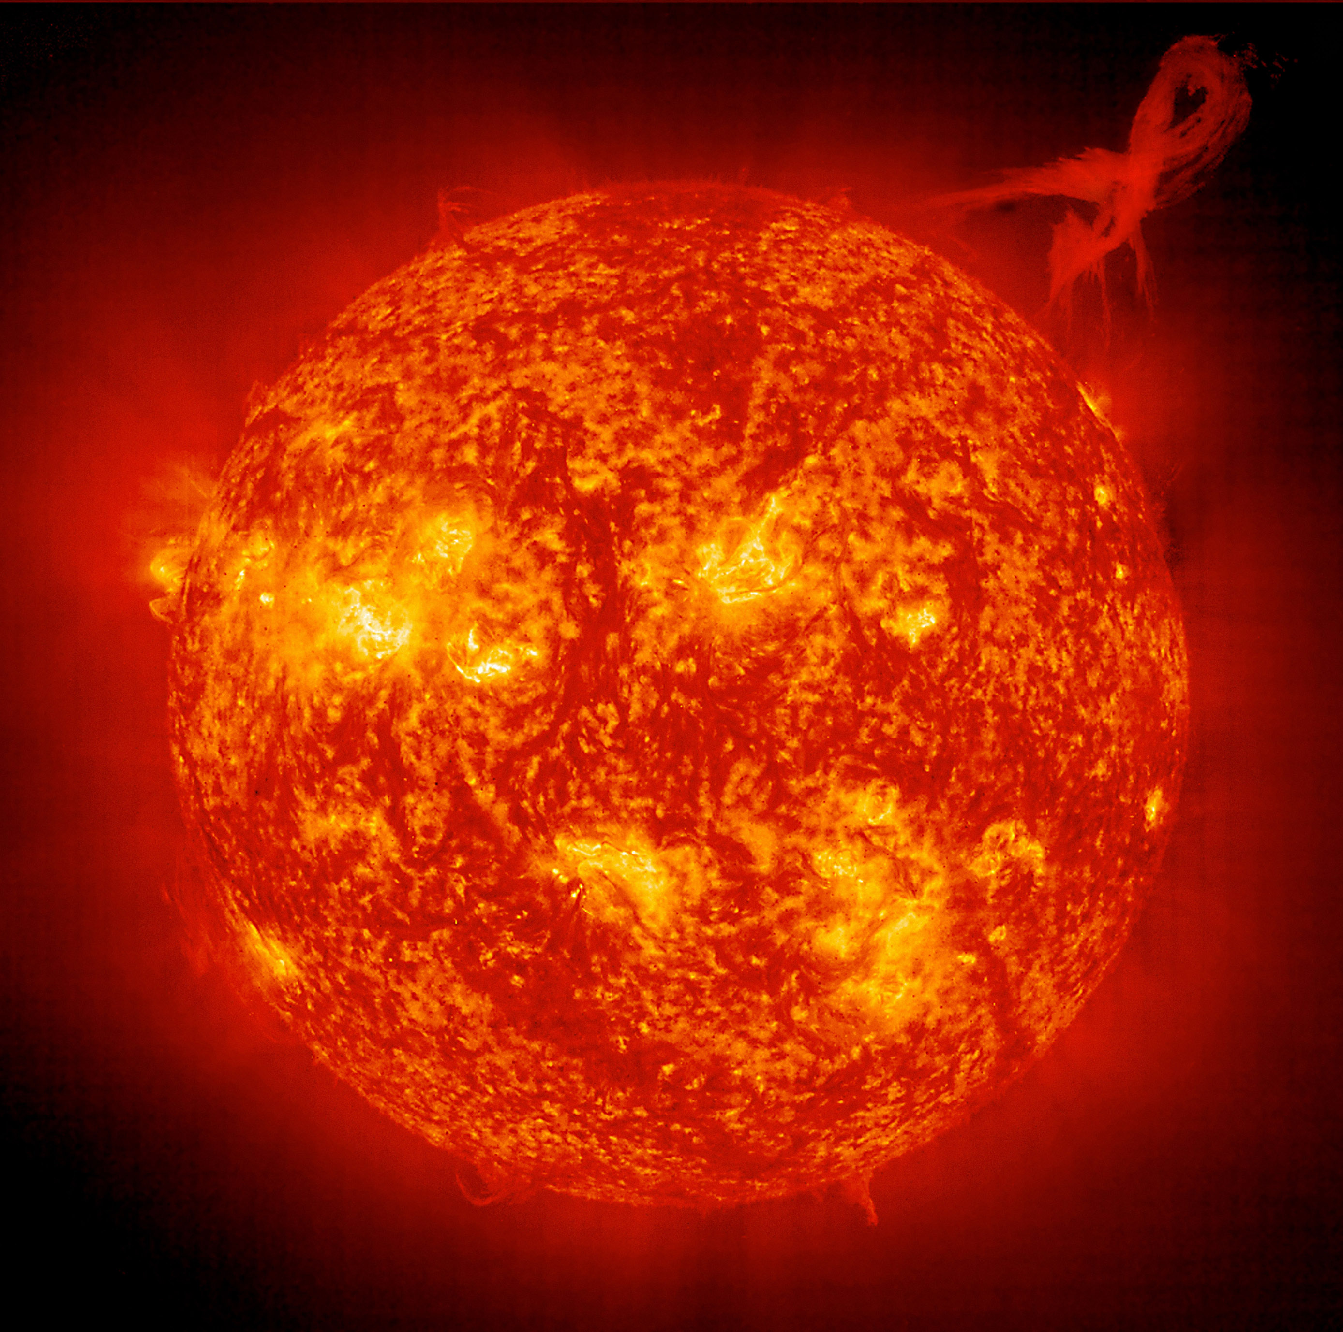
The Main Sequence
The longest phase of a star’s life
Converts hydrogen into helium
Nothing much changes
Slowly gets bigger and brighter
Image: NASA

Slide 8
How long?
Not all of a star is hot enough to burn
More massive stars are hotter
They burn through their fuel faster
The Sun has burned about half it’s fuel in 4.56 billion years
Massive stars take only 10-100 million years

Slide 9
Sun’s internal composition over time
Surface
Hydrogen
Hydrogen
Hydrogen
Helium
Centre
t = 0
t = 4.57 billion years
t = 11 billion years

Slide 10
The Red Giant Branch
The Sun swells up to around 200 times its current size
Hydrogen burns in a shell around the core
The core gets more and more compact, and hotter and hotter.
This takes about a billion years
200 R⊙
Hydrogen
0.0240 R⊙
0.47 M⊙
Helium

Slide 11
Main sequence
Red giants

Slide 12
The Fates of Stars
Initial mass (Solar masses)
Core hydrogen burning
0.08
He WD
Core helium burning
0.5
Evolution stage reached

Slide 13
Core helium burning
If a star can reach a temperature of 10⁸ K, helium fusion can happen
Core helium burning is a bit like core hydrogen burning
It doesn’t release as much energy, so it doesn’t last as long
Burning continues in a shell once the core helium is used up

Slide 14
Core helium burning

Slide 15
The Fates of Stars
Initial mass (Solar masses)
Core hydrogen burning
0.08
He WD
Core helium burning
0.5
AGB
Evolution stage reached
0.8
7

Slide 16

The Asymptotic Giant Branch (AGB)
0.54 M⊙
These stars never get hot enough to burn carbon
The structure isn’t stable
Periodic runaway helium burning
Thermal pulses
With interesting consequences for nucleosynthesis
0.51 M⊙
C/O core
He
H
0.02 R⊙
0.1 R⊙
300 R⊙
Notes:
The Pint Standard: H-shell is 1cm, He-shell is 1mm. Surface is 15-20 m

Slide 17
1. H-burning produces He
C/O core
He
H

Slide 18
2. He burning ignites,
drives convection between shells

Slide 19
2. He burning ignites,
drives convection between shells
He burning ashes: ¹²C

Slide 20
3. He-burning shuts off, expansion cools the H-shell

Slide 21
4. Convective envelope penetrates inward
¹²C

Slide 22
5. H-burning reignites and it all happens again!
C/O core
He
H

Slide 23
Low mass star nucleosynthesis
Lots of nucleosynthesis happens during this phase
Carbon, nitrogen, fluorine, sodium
About 1/3 to 1/2 of the Universe’s carbon comes from AGB stars
Heavy elements are made by the s-process
Strontium, zirconium, barium, lanthanum, lead

Slide 24
Notes:
Caveat – at the present day!

Slide 25
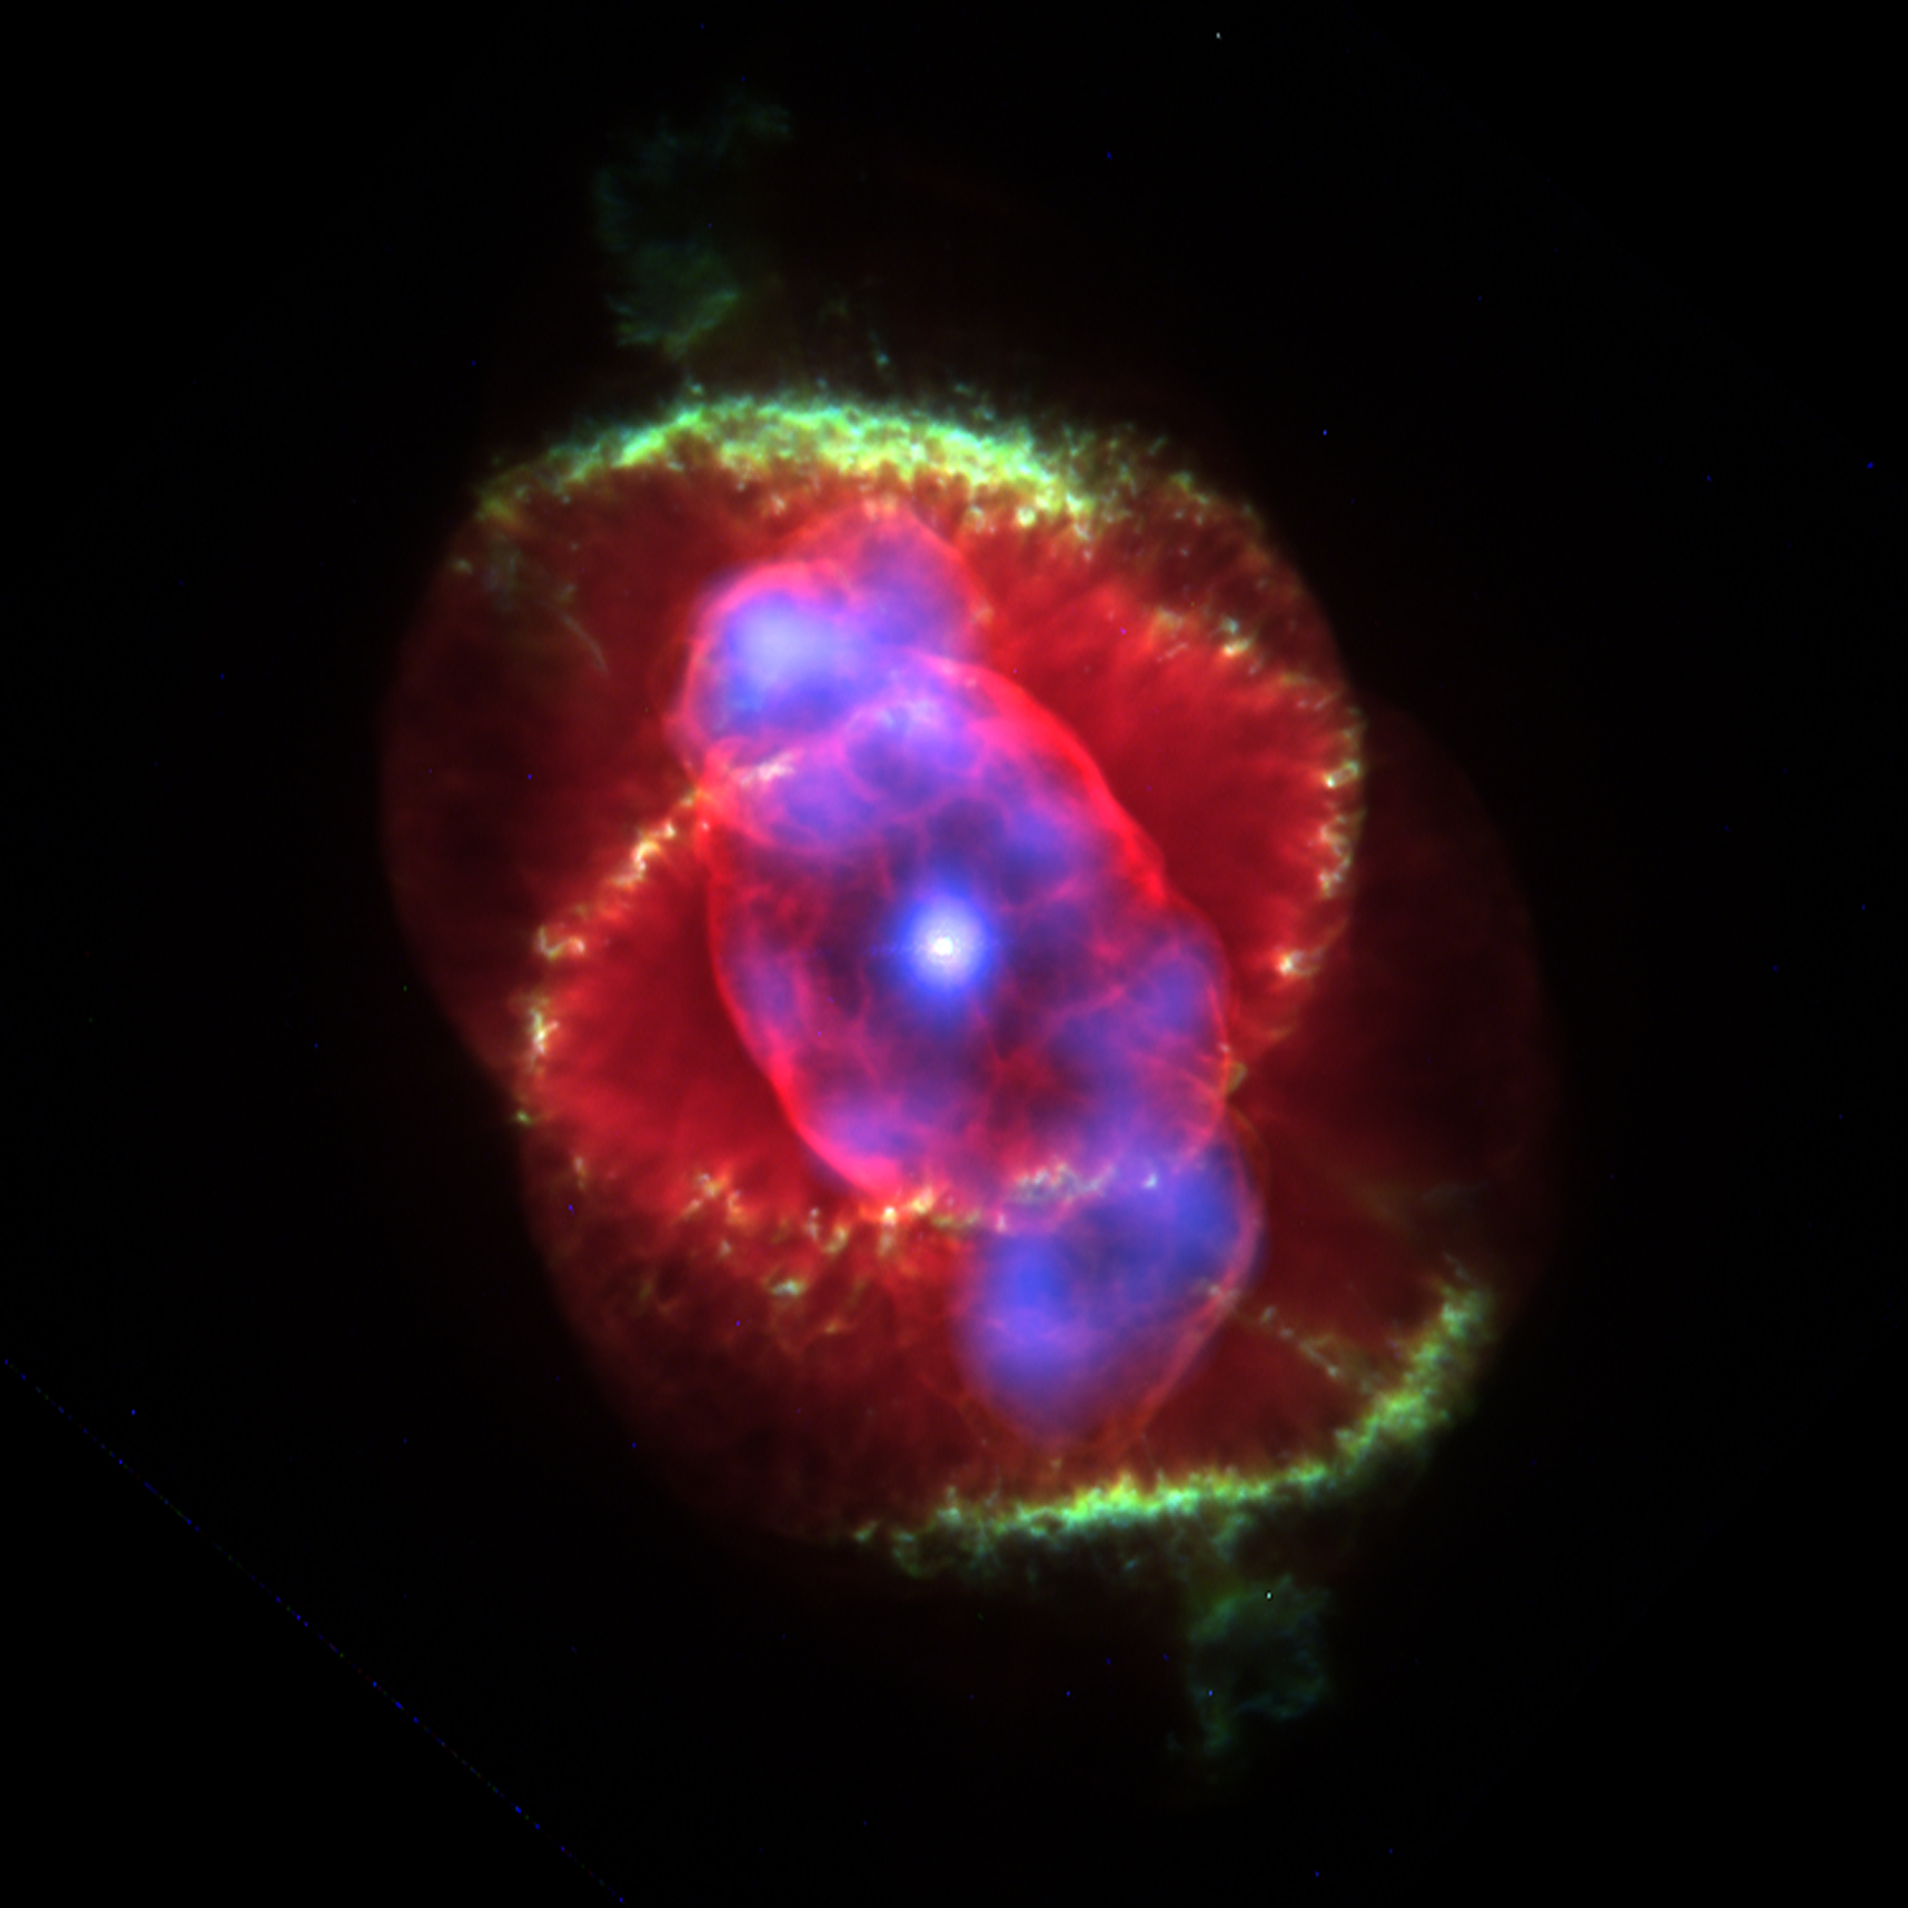
The end: mass loss
Material gets blown off the star
After about 1 million years all but the core of the star is left
This is a white dwarf
The hot core ionises the ejected material
Planetary nebula
This lasts for a few 10,000 years
NGC6543 (Cat’s Eye Nebula). Credit: NASA

Slide 26
Timescales
Initial Mass (Msun) | Final Mass (Msun) | Main seq. lifetime (Gyr) | EAGB lifetime (Myr) | % of MS lifetime | TP-AGB lifetime (Myr) | % of MS lifetime
1.0 | 0.57 | 11.3 | 12 | 0.16 | 0.50 | 0.004
1.5 | 0.60 | 2.7 | 9.2 | 0.34 | 0.83 | 0.03
2.0 | 0.63 | 1.2 | 7.9 | 0.66 | 1.20 | 0.10
2.5 | 0.67 | 0.62 | 1.1 | 0.18 | 2.20 | 0.35
3.5 | 0.75 | 0.23 | 2.8 | 1.2 | 0.43 | 0.19
5.0 | 0.89 | 0.10 | 1.2 | 1.2 | 0.26 | 0.27
Vassiliadias & Wood (1993)
Less than 1% of a star’s life is spent on the TP-AGB!
But it’s the most important phase for nucleosynthesis!

Slide 27
The Fates of Stars
Initial mass (Solar masses)
Core hydrogen burning
0.08
He WD
Core helium burning
0.5
AGB
Core carbon burning
Evolution stage reached
0.8
CO white dwarf
Super AGB
Fusion up to iron
10

Slide 28
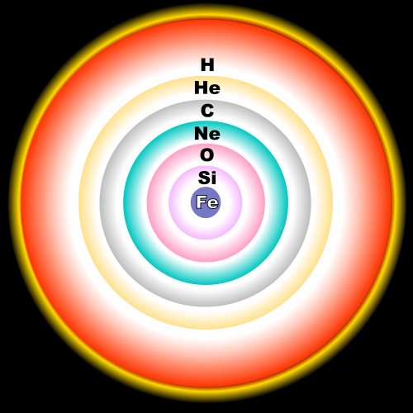
The structure of massive stars
Stars of 10 solar masses can fuse up to iron
They have an onion-like structure
Once they form iron, no more fusion is possible…

Slide 29
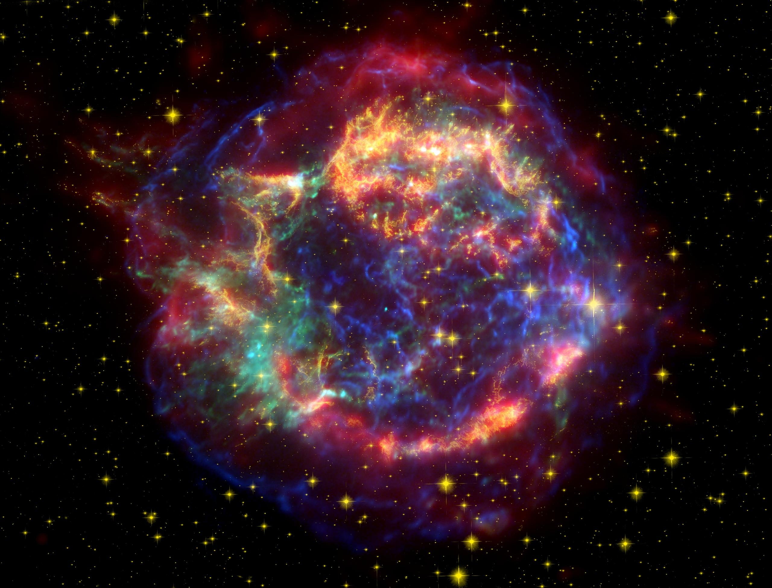
Supernovae (Core-collapse or Type II)
No more pressure support from fusion
The outer layers collapse on to the iron core
They rebound and are ejected
Very energetic event!
Cassiopeia A (O. Krause, Steward Obs.)

Slide 30
Supernova remnants
Supernovae produce very pretty remnants!
Ejected material rich in:
Oxygen, iron, heavy elements
More importantly they leave behind very compact cores
Neutron stars
Black holes
Cassiopeia A (O. Krause, Steward Obs.)

Slide 31
Notes:
Caveat – at the present day!

Slide 32
The Fates of Stars
Initial mass (Solar masses)
Core hydrogen burning
0.08
He WD
Core helium burning
0.5
AGB
Core carbon burning
Evolution stage reached
0.8
CO white dwarf
Super AGB
Fusion up to iron
10
ONe WD
Neutron star
Black hole
7
10
25

Slide 33
Only half of the story!
About half of all stars are in binary systems
If they are close enough together, they can interact
Some things we see have to come from binary systems!
Type 1a supernovae
Gravitational waves

Slide 34
Liu, Stancliffe, Abate, Matrozis (2017)

Slide 35
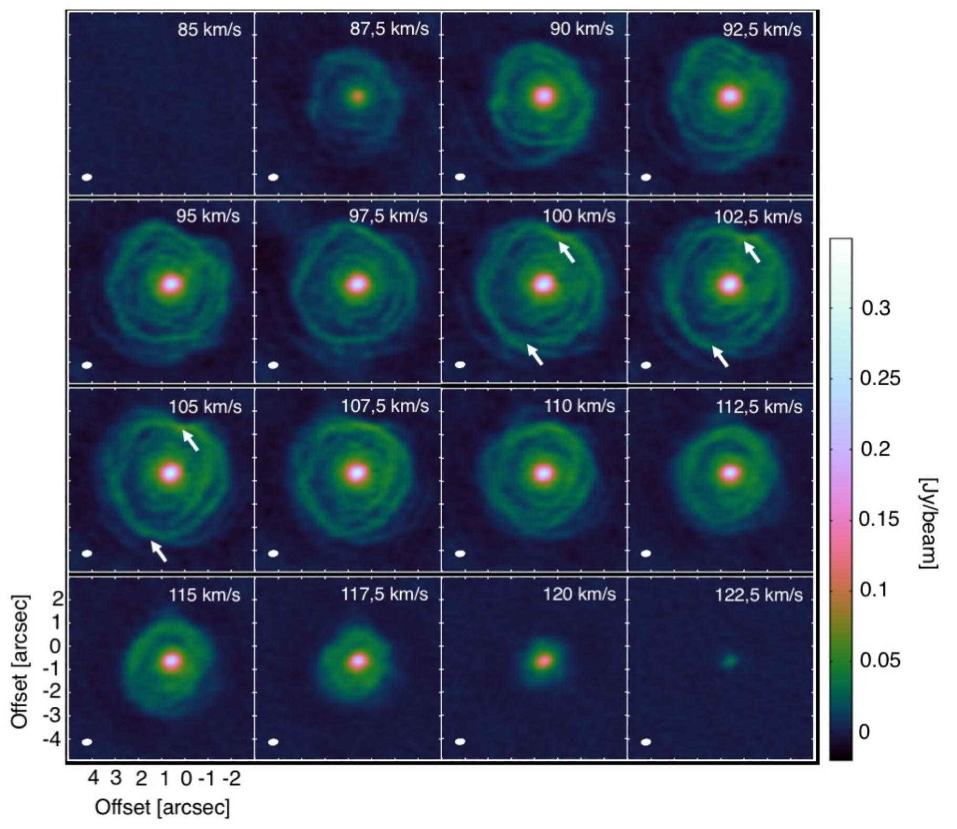
Decin et al. (2019)

Slide 36
Summary
Initial mass controls the fate of a star
The more massive, the faster a star burns
The more massive, the more stages it gets through
Low mass stars end up as white dwarfs
Massive stars explode as supernova
More from Claire on Thursday!

